Slide 2
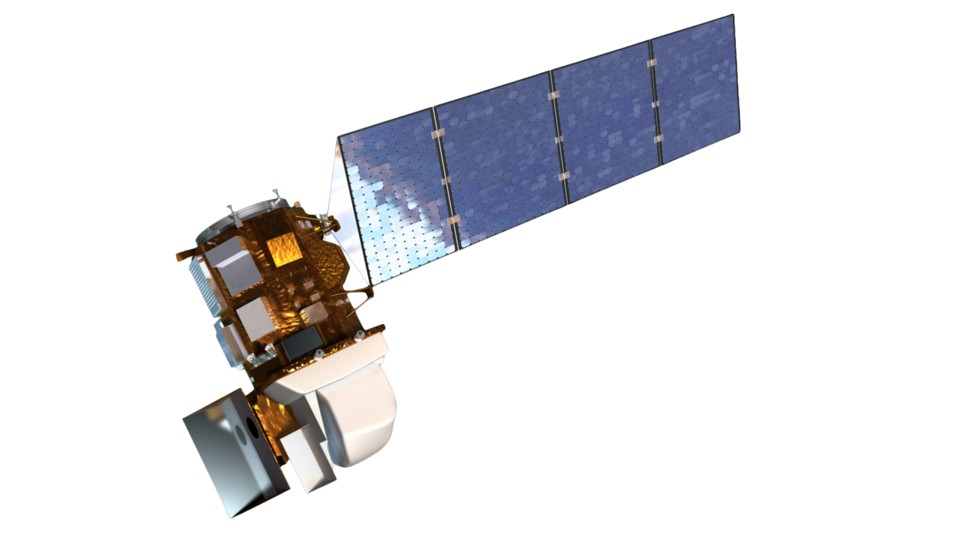
SPATIAL
0.1
0.5
1.0
1.5
2.0
5.0
10.0
15.0
30.0
50.0
100.0
>100
m
SPECTRAL
100
200
300
400
500
600
700
800
900
1,10³
1.2,10³
1.5,10³
nm
RADIAL
0
4
16
256
65,536
Bits (Multi-Spectral)
LANDSAT-8
NASA
0
4
16
256
65,536
Bits (Pan-sharpened)
TEMPORAL
0
1
2
3
4
5
6
7
8
9
10
>10
Days

Slide 3
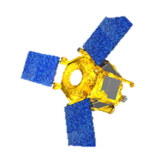
SPATIAL
0.1
0.5
1.0
1.5
2.0
5.0
10.0
15.0
30.0
50.0
100.0
>100
m
SPECTRAL
100
200
300
400
500
600
700
800
900
1,10³
1.2,10³
1.5,10³
nm
RADIAL
0
4
16
256
65,536
Bits (Multi-Spectral)
SPOT-6
AIRBUS
0
4
16
256
65,536
Bits (Pan-sharpened)
TEMPORAL
0
1
2
3
4
5
6
7
8
9
10
>10
Days

Slide 4
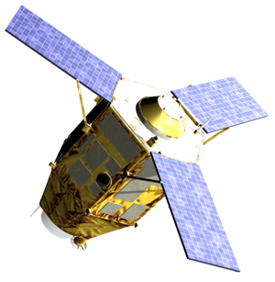
SPATIAL
0.1
0.5
1.0
1.5
2.0
5.0
10.0
15.0
30.0
50.0
100.0
>100
m
SPECTRAL
100
200
300
400
500
600
700
800
900
1,10³
1.2,10³
1.5,10³
nm
RADIAL
0
4
16
256
65,536
Bits (Multi-Spectral)
PLEAIDES-1A
AIRBUS
0
4
16
256
65,536
Bits (Pan-sharpened)
TEMPORAL
0
1
2
3
4
5
6
7
8
9
10
>10
Days

Slide 5
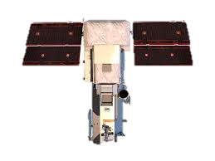
SPATIAL
0.1
0.5
1.0
1.5
2.0
5.0
10.0
15.0
30.0
50.0
100.0
>100
m
SPECTRAL
100
200
300
400
500
600
700
800
900
1,10³
1.2,10³
1.5,10³
nm
RADIAL
0
4
16
256
65,536
Bits (Multi-Spectral)
WORLDVIEW-3 DIGITALGLOBE
0
4
16
256
65,536
Bits (Pan-sharpened)
TEMPORAL
0
1
2
3
4
5
6
7
8
9
10
>10
Days

Slide 6
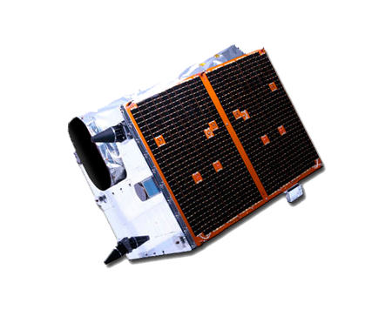
SPATIAL
0.1
0.5
1.0
1.5
2.0
5.0
10.0
15.0
30.0
50.0
100.0
>100
m
SPECTRAL
100
200
300
400
500
600
700
800
900
1,10³
1.2,10³
1.5,10³
nm
RADIAL
0
4
16
256
65,536
Bits (Multi-Spectral)
RAPID-EYE
PLANET
0
4
16
256
65,536
Bits (Pan-sharpened)
TEMPORAL
0
1
2
3
4
5
6
7
8
9
10
>10
Days

Slide 7
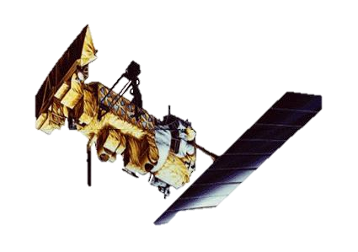
SPATIAL
0.1
0.5
1.0
1.5
2.0
5.0
10.0
15.0
30.0
50.0
100.0
>100
m
SPECTRAL
100
200
300
400
500
600
700
800
900
1,10³
1.2,10³
1.5,10³
nm
RADIAL
0
4
16
256
65,536
Bits (Multi-Spectral)
POES
NOAA NASA
0
4
16
256
65,536
Bits (Pan-sharpened)
TEMPORAL
0
1
2
3
4
5
6
7
8
9
10
>10
Days

